Slide 1

SentinelAI: A Multi-Agent Urban Digital Twin for Predictive Disaster Intelligence and Autonomous Emergency Response
Presented by:
Santhosh Kumar B [192511053]
Ganji Madhan Kumar [192472328]
Avishek N [192511009]
[CSA1709]-[Artificial Intelligence]
Guided By:
Dr P Rajaram

Slide 2
Introduction
Overview of the Project
Develops an AI-powered Urban Digital Twin for disaster prediction and emergency response.
Integrates Weather APIs, IoT sensors, CCTV feeds, and citizen reports for real-time monitoring.
Uses AI agents to detect disasters, optimize resource allocation, and support emergency decisions.
Provides live visualization of risk zones, emergency routes, hospitals, and shelters.
Enhances coordination between authorities and citizens through a unified emergency platform.
Problem Statement
Delayed emergency response due to fragmented data and poor coordination.
Lack of centralized monitoring for disasters and emergency resources.
Manual verification slows critical emergency operations.
Need for an AI-driven real-time disaster management system.
Purpose of the Project
To develop an AI-powered Urban Digital Twin for disaster management.
To predict disasters using real-time data from multiple sources.
To optimize emergency response through intelligent resource allocation.
To improve coordination between citizens and emergency authorities.

Slide 3
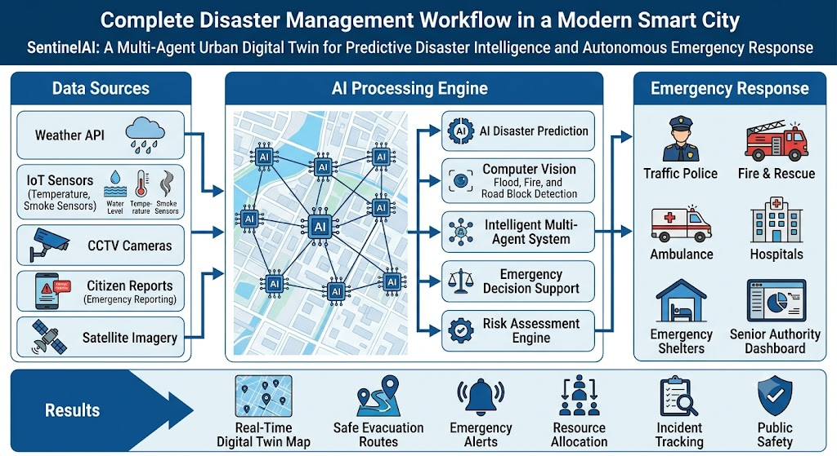
Objectives
To develop an AI-powered Urban Digital Twin for disaster management.
To integrate real-time data from weather, IoT sensors, CCTV, and citizens.To detect disasters using Artificial Intelligence and Computer Vision.
To optimize emergency response and evacuation routes using AI.
To improve coordination between citizens and emergency authorities.
To enhance public safety through intelligent decision support.

Slide 4
Literature Review / Background
S.No | Title | Authors & Year | Methodology Used | Key Findings
1 | Continuing from the Sendai Framework Midterm: Opportunities for Urban Digital Twins in Disaster Risk Management | Biao He et al., 2024 | Urban Digital Twin and disaster risk analysisImproved disaster monitoring and decision support | Urban Digital Twin and disaster risk analysisImproved disaster monitoring and decision support
2 | Digital Twin Approach for Enhancing Urban Resilience: A Cycle Between Virtual Space and the Real World | Wang et al., 2024 | Digital Twin with urban resilience frameworkEnhanced emergency planning and city resilience | Digital Twin with urban resilience frameworkEnhanced emergency planning and city resilience
3 | Digital Post-Disaster Risk Management Twinning: A Review and Improved Conceptual Framework | Sharma et al., 2024 | AI-enabled Digital Twin frameworkBetter disaster response and resource coordination | AI-enabled Digital Twin frameworkBetter disaster response and resource coordination
4 | A Review of Digital Twin Applications in Civil and Infrastructure Emergency Management | Zhang et al., 2023 | Digital Twin and emergency management reviewImproved infrastructure monitoring and emergency response | Digital Twin and emergency management reviewImproved infrastructure monitoring and emergency response
5 | Intelligent Emergency Digital Twin System for Monitoring Building Fire Evacuation | Ding et al., 2023 | Computer Vision with Digital TwinReal-time evacuation monitoring and decision support | Computer Vision with Digital TwinReal-time evacuation monitoring and decision support

Slide 5
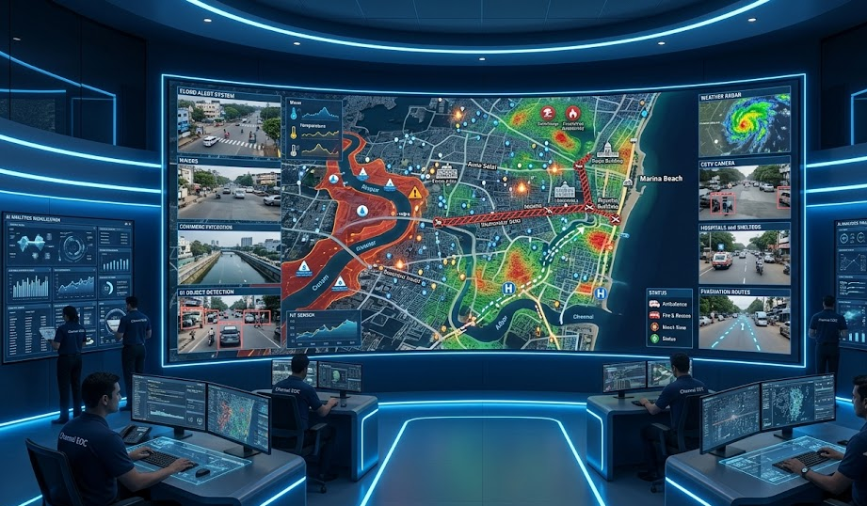
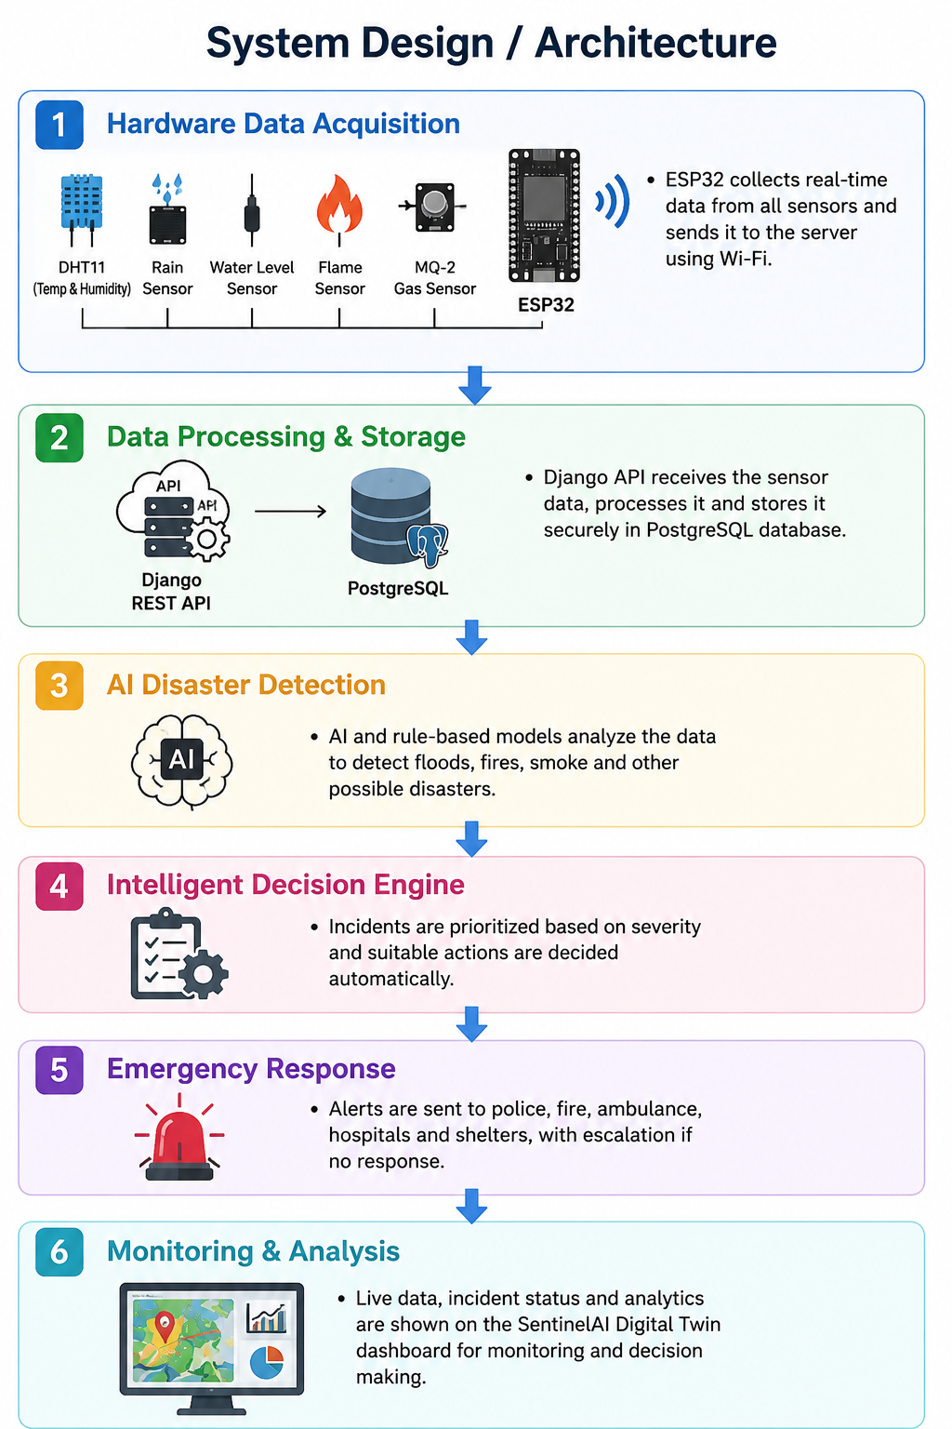
System Design / Architecture
1️⃣ Data Acquisition
Collect data from Weather APIs, IoT sensors, CCTV, and citizen reports.
Gather real-time traffic, location, and environmental information.
⬇️
2️⃣ Data Processing
Clean, validate, and integrate data from multiple sources.
Prepare data for AI-based analysis and prediction.
⬇️
⬇️
3️⃣ 3. AI Disaster Detection
Detect floods, fires, road blockages, and other emergencies.
Assess disaster severity using AI and Computer Vision.
6️⃣ Monitoring & Analysis
Update the Digital Twin dashboard with live incident status.
Enable citizen tracking, officer monitoring, and analytics.
⬇️
⬇️
4️⃣ Intelligent Decision Engine
Prioritize incidents based on severity.
Assign nearest emergency resources and optimize routes using A* Search.
5️⃣ Emergency Response
Notify traffic police, fire, ambulance, hospitals, and shelters.
Apply escalation if officers do not respond within the time limit.

Slide 6
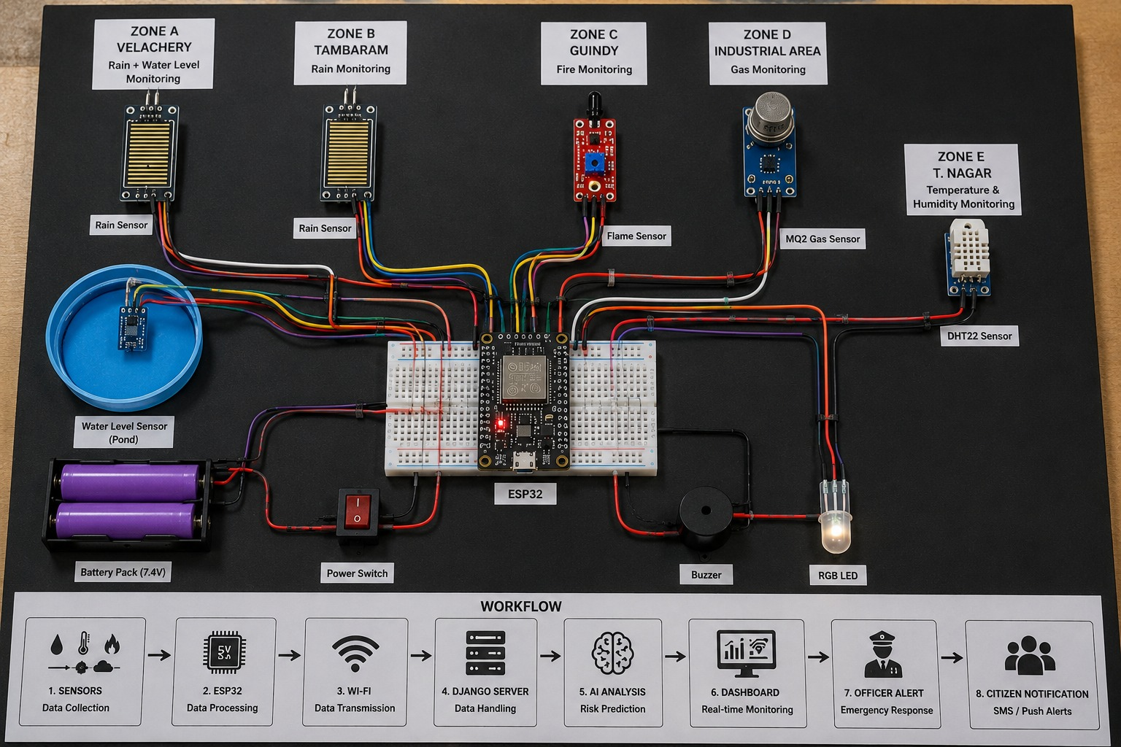
Hardware Components Used
Component | Purpose
ESP32 Development Board | Main IoT controller; collects sensor data and sends it to Django via Wi-Fi
DHT11 Sensor | Measures temperature and humidity
Rain Sensor | Detects rainfall / moisture conditions
Water Level Sensor | Monitors water level for flood-risk detection
Flame Sensor | Detects flame/fire conditions
MQ-2 Gas Sensor | Detects smoke and combustible gases
Buzzer | Local emergency alert
LED | Visual status/alert indication
Breadboard | Prototyping and connecting components
Jumper Wires | Electrical connections between ESP32 and sensors
USB Cable | ESP32 programming and power supply

Slide 7
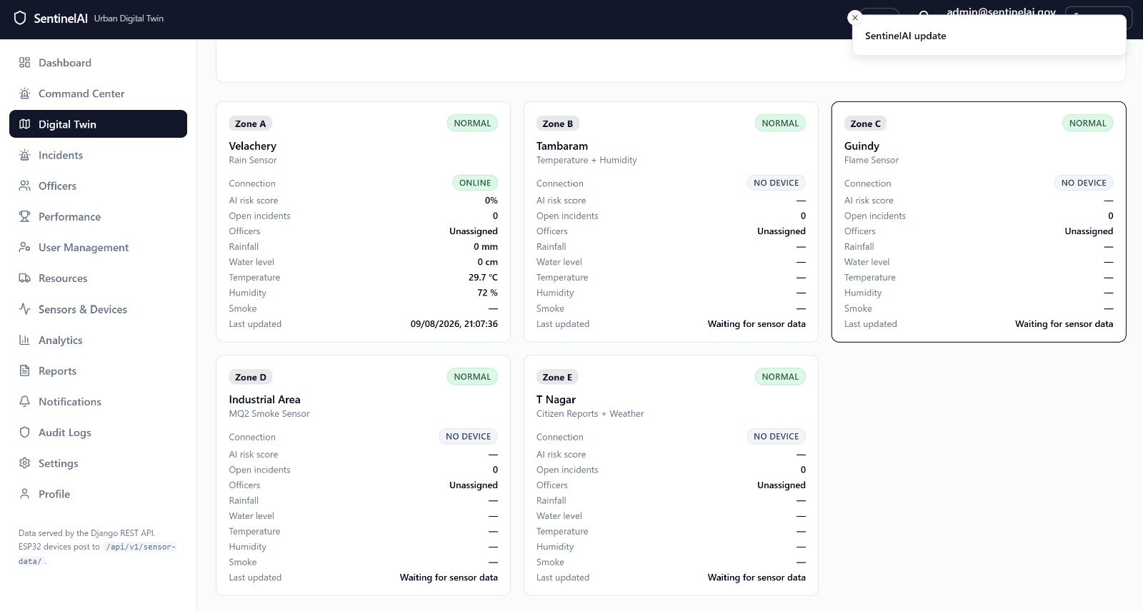
Implementation
Module 1: AI-Based Disaster Detection & Prediction
This module collects real-time information from weather services, IoT sensors, CCTV cameras, satellite imagery, and citizen reports. Artificial Intelligence analyzes the incoming data to detect potential disasters such as floods, fires, road blockages, and hazardous situations.
The system continuously predicts high-risk areas and generates early warning alerts. AI models identify disaster severity and update the Digital Twin city map for real-time situational awareness.
Key Features:
Real-time multi-source data integration.
AI-based disaster prediction and risk assessment.
Computer Vision for incident detection.
Digital Twin city risk visualization.
Automated early warning generation.
Continuous monitoring of disaster-prone areas.

Slide 8
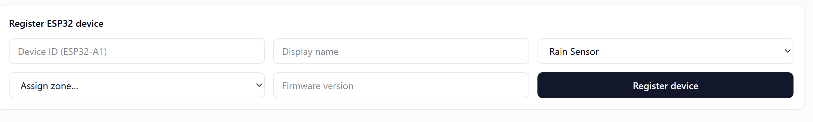
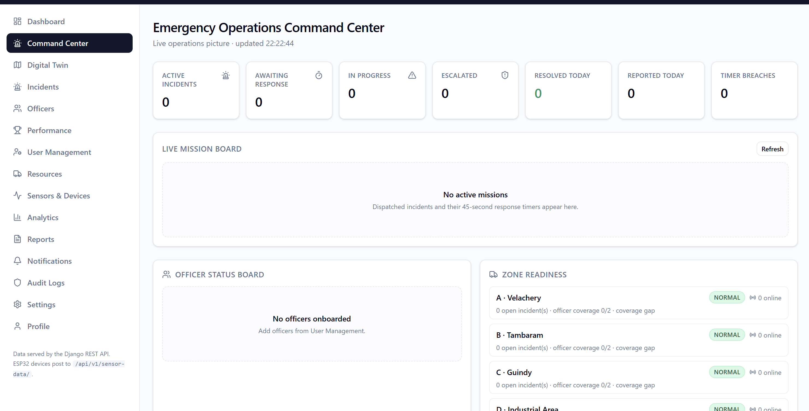
Module 2: Intelligent Resource Allocation & Emergency Response
This module assigns emergency resources using intelligent search algorithms and multi-agent systems. Based on disaster severity, the system allocates police, ambulances, fire services, hospitals, and rescue teams to the most critical locations.
The system calculates optimal evacuation routes while considering traffic conditions, blocked roads, and resource availability to minimize emergency response time.
Key Features:
AI-based emergency resource allocation.
Intelligent evacuation route optimization.
Multi-agent emergency coordination.
Live officer and vehicle tracking.
Hospital and shelter availability monitoring.
Automatic incident prioritization.

Slide 9
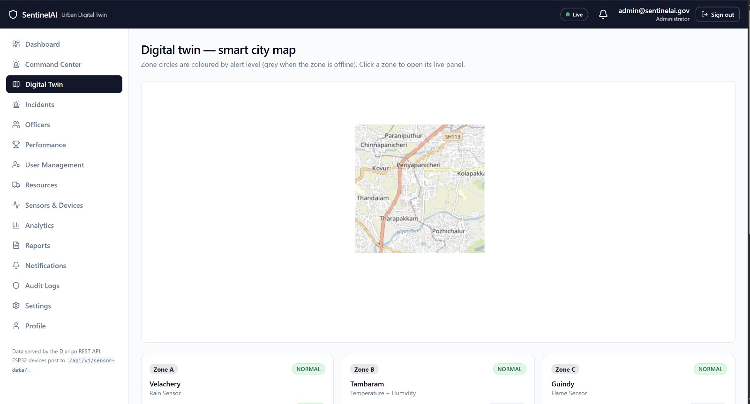
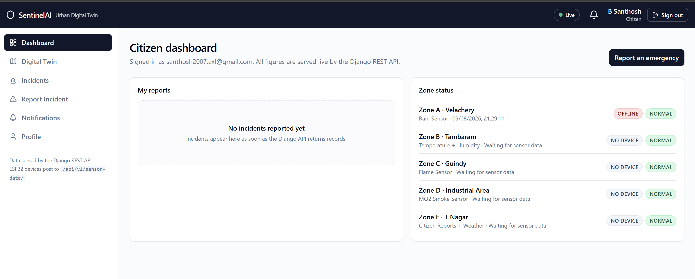
Module 3: Citizen Reporting & Centralized Decision Support
This module enables citizens to report emergencies through a secure token-based reporting system without revealing personal identity. Reports are verified by nearby officers and monitored through a centralized emergency command dashboard.
The platform supports escalation mechanisms, live notifications, performance analytics, and real-time coordination among officers and government authorities for efficient disaster management.
Key Features:
Token-based anonymous citizen reporting.
Officer verification and escalation workflow.
Centralized emergency command dashboard.
Live alerts and notification system.
Incident analytics and performance monitoring.
Real-time coordination between citizens and authorities.

Slide 10
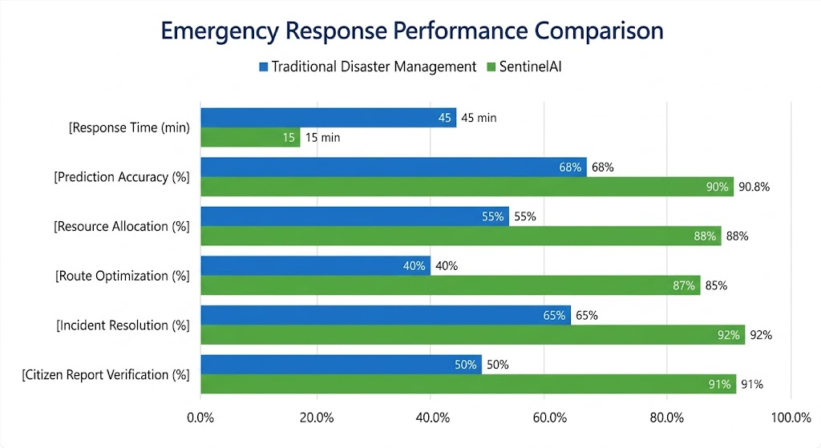
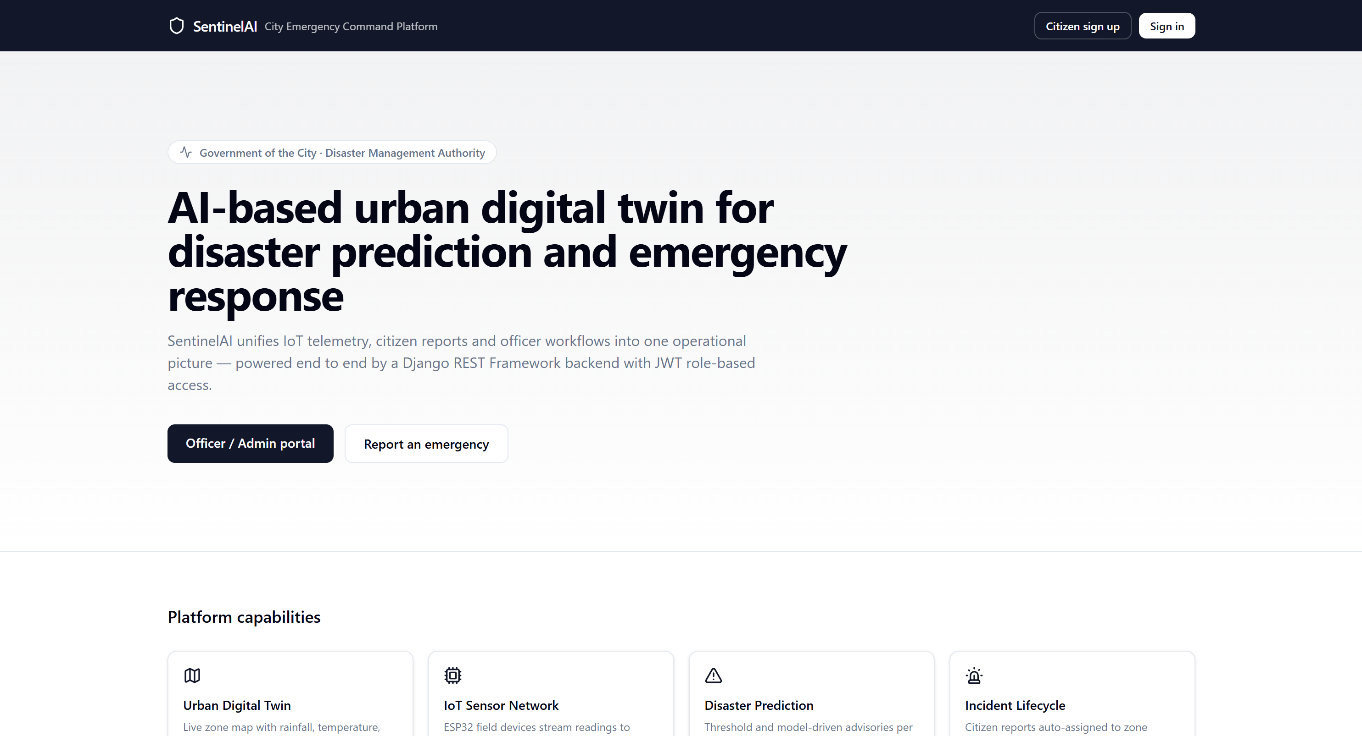
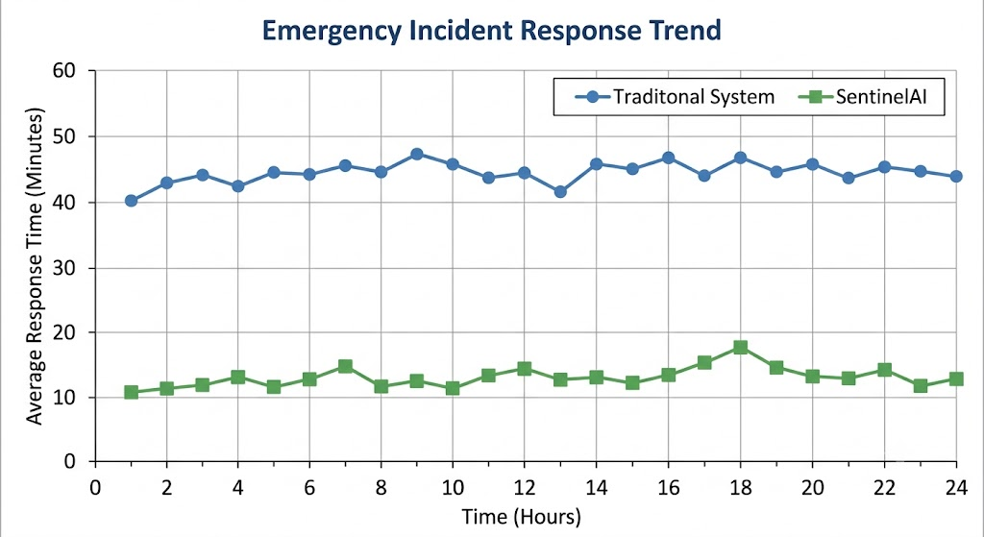
Results & Discussion
Outcomes of the Project
AI-powered disaster monitoring and prediction successfully integrated.
Real-time Digital Twin visualizes disaster-prone areas on a city map.
Emergency incidents prioritized based on severity and risk level.
AI optimizes evacuation routes and emergency resource allocation.
Citizen reports and officer responses tracked through a centralized dashboard.
Faster emergency coordination and improved decision support.
Key Advantage: Provides real-time AI-based disaster prediction, intelligent resource allocation, and centralized emergency management through an Urban Digital Twin platform..

Slide 11
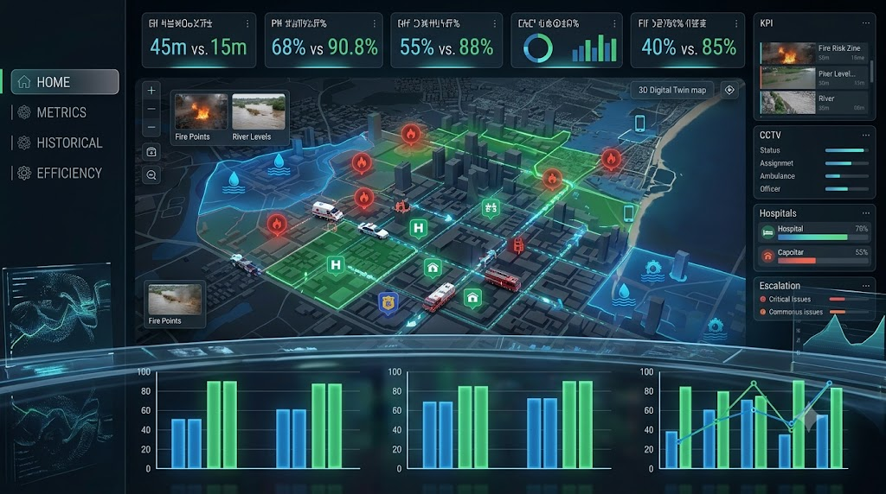
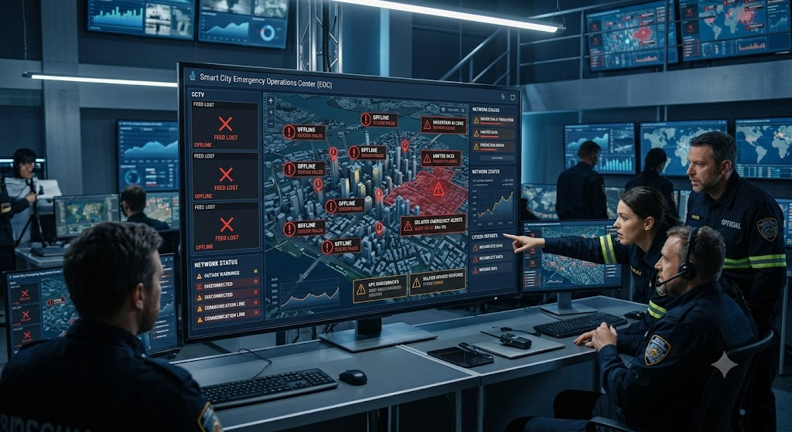
Challenges and Limitations
Integrating real-time data from weather services, IoT sensors, CCTV, and citizen reports.
Ensuring accurate disaster prediction under dynamic urban conditions.
Optimizing emergency resource allocation and evacuation routes in real time.
Coordinating multiple emergency agencies through a unified AI platform.
Maintaining low-latency communication for critical emergency response.
Prediction accuracy depends on the availability and quality of real-time data.
Sensor failures or network outages may affect system performance.
AI predictions require verification before emergency actions are initiated.
Large-scale deployment requires smart city infrastructure and government support.
Privacy and security must be ensured

Slide 12
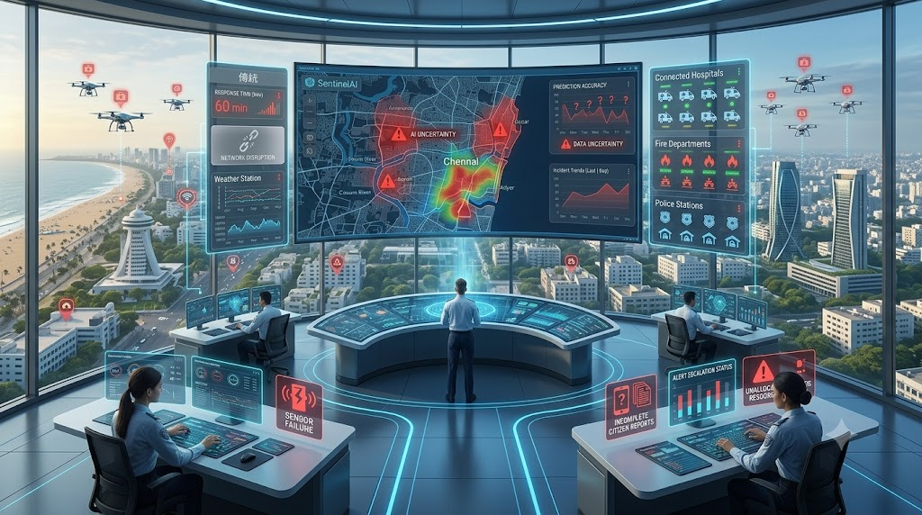
Future Scope
The proposed system can be extended into a large-scale smart city platform by integrating advanced AI models, autonomous emergency systems, and government infrastructure. Future enhancements can improve disaster prediction accuracy, automate emergency response, and strengthen coordination among public safety agencies.Future Enhance
Future Enhancements:
Integrate drone and satellite imagery for rapid disaster assessment.
Deploy Edge AI for faster real-time prediction and low-latency response.
Support autonomous emergency vehicles and smart traffic signal control.
Enhance AI models using historical disaster and climate datasets.
Expand the platform for nationwide smart city disaster management.
Integrate multilingual AI chatbots and voice assistants for citizen support.
Develop mobile applications with offline emergency reporting and alerts.
Incorporate blockchain for secure emergency data sharing and incident records.

Slide 13



Project Alignment with Sustainable Development Goals
SDG 11 – Sustainable Cities and Communities
Develops an AI-powered Digital Twin platform for disaster prediction, emergency response, and urban resilience, helping create safer and smarter cities.
SDG 9 – Industry, Innovation and Infrastructure
Leverages Artificial Intelligence, IoT, Computer Vision, and Digital Twin technologies to modernize emergency management infrastructure and improve disaster response systems.
SDG 13 – Climate Action
Supports early detection and prediction of climate-related disasters such as floods, storms, and wildfires, enabling proactive response and reducing disaster impact.

Slide 14
Conclusion
The SentinelAI: Multi-Agent Urban Digital Twin for Predictive Disaster Intelligence and Autonomous Emergency Response provides an intelligent solution for real-time disaster prediction and emergency management. By integrating Artificial Intelligence, Digital Twin technology, Computer Vision, IoT, and intelligent search algorithms, the system enables early disaster detection, optimized resource allocation, and faster emergency response. It improves coordination among citizens, emergency responders, and government authorities, contributing to safer and more resilient smart cities.
Key Takeaways:
AI enables real-time disaster prediction and risk assessment.
Digital Twin technology provides live monitoring of urban environments.
Intelligent agents optimize emergency resource allocation and evacuation routes.
Centralized dashboards improve coordination between citizens and authorities.
Supports faster response, enhanced public safety, and future smart city initiatives.

Slide 15
References
1.He, B., Zhang, Y., & Li, X. (2024). Continuing from the Sendai Framework midterm: Opportunities for urban digital twins in disaster risk management. International Journal of Disaster Risk Reduction, 101, 104437 https://doi.org/10.1016/j.ijdrr.2024.104437.
2.Wang, J., Zhang, H., & Chen, Y. (2024). Digital twin approach for enhancing urban resilience: A cycle between virtual space and the real world. Smart Cities, 7(2), 482–503 https://www.sciencedirect.com/science/article/pii/S2772741624000231.
3.Zhang, Y., Li, H., & Wang, S. (2023). A review of digital twin applications in civil and infrastructure emergency management. Buildings, 13(5), 1143.https://www.mdpi.com/2075-5309/13/5/1143
4.Ding, L., Zhang, Y., & Huang, Z. (2023). Intelligent emergency digital twin system for monitoring building fire evacuation. Automation in Construction, 154, 105060.
https://ira.lib.polyu.edu.hk/handle/10397/108029
5.Russell, S., & Norvig, P. (2022). Artificial Intelligence: A Modern Approach (4th Global ed.). Pearson. https://aima.cs.berkeley.edu/
6.Alpaydın, E. (2020). Introduction to Machine Learning (4th ed.). MIT Press https://mitpress.mit.edu/9780262043793/introduction-to-machine-learning/.
7.Goodfellow, I., Bengio, Y., & Courville, A. (2016). Deep Learning MIT Press.https://www.deeplearningbook.org/.
8.Hart, P. E., Nilsson, N. J., & Raphael, B. (1968). A formal basis for the heuristic determination of minimum cost paths. IEEE Transactions on Systems Science and Cybernetics, 4(2), 100–107 https://doi.org/10.1109/TSSC.1968.300136.
9.Dorigo, M., & Birattari, M. (2010). Ant colony optimization. In Encyclopedia of Machine Learning (pp. 36–39). Springer. https://doi.org/10.1007/978-0-387-30164-8_22.
10.OpenStreetMap Foundation. (2026). OpenStreetMap. https://www.openstreetmap.org

Slide 16


